Slide 1

LIBRARY MANAGEMENT TOOL

Slide 2
Introduction
“Vedas” is an online library management tool developed for the purpose of easy handling library related transactions.

Slide 3
TABLES
There are nine tables in my database which are sufficient to perform the function of a library.
admins
author
authorbook
authorcat
books
borrower
issue
placing
publisher

Slide 4
INTEGRITY CONSTRAINTS
I have used the integrity constraint to maintain the consistency of data so that there is no data which is defying the rules.
It includes:
Primary Key
Foreign Key
Not Null
Check

Slide 5
PRIMARY KEY IN PROJECT
I have used the primary key in each and every table to uniquely identify each row.
admins(id)
author(id)
authorbook(a_id,b_id)
authorcat(a_id,category)
books(id)
borrower(id)
issue(borrower_id,book_id)
placing(book_id)
publisher(id)

Slide 6
FOREIGN KEY IN PROJECT
I have used the foreign key for referential integrity constraint so that data in the database is related.
authorbook(a_id) author(id)
authorbook(b_id) books(id)
authorcat(a_id) author(id)
books(publisher_id) publisher(id)
issue(borrower_id) borrower(id)
issue(book_id) books(id)
placing(book_id) books(id)

Slide 7
NOT NULL AND CHECK
I have implemented these constraints from the php script and HTML .
To implement the not null constraint required=“required” attribute is used in the input tag of the form in html.
If user left the column empty then a dialog box appears and tells the user to enter the value.
For check constraint I have used if and nested if conditions of php and checked the values before they are actually inserted in the database.

Slide 8
NORMALIZATION
All the tables in the database are in Boyce Codd Normal Form.
There are no multivalued attributes and each attribute is determined directly by the primary key of the relation.
For this purpose several tables are exclusively created like :
authorcat :- Multiple category of a author
authorbook :- Multiple authors of a single book

Slide 9
TOOLS
FRONT END
HTML
CSS

Slide 10
BACK END
MYSQL
PHP

Slide 11
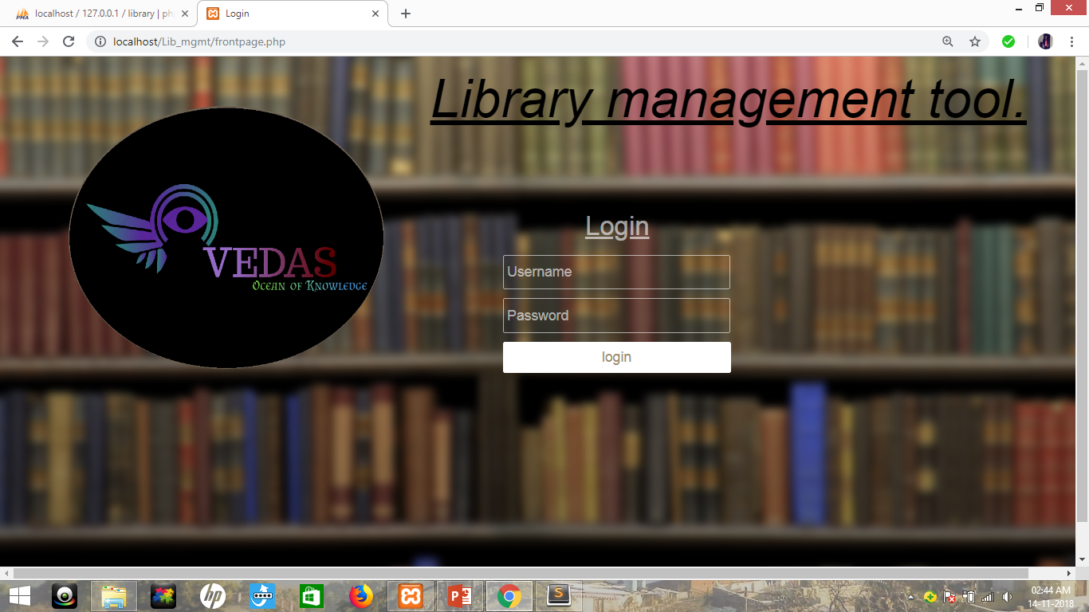
LOGIN PROTECTION
I have used login protection in this tool to prevent unauthorized access.
Currently it is limited to only one user.

Slide 12
WORKING
PHP
DATABASE SERVER
PHP
HTML
USER
HTML FORM

Slide 13
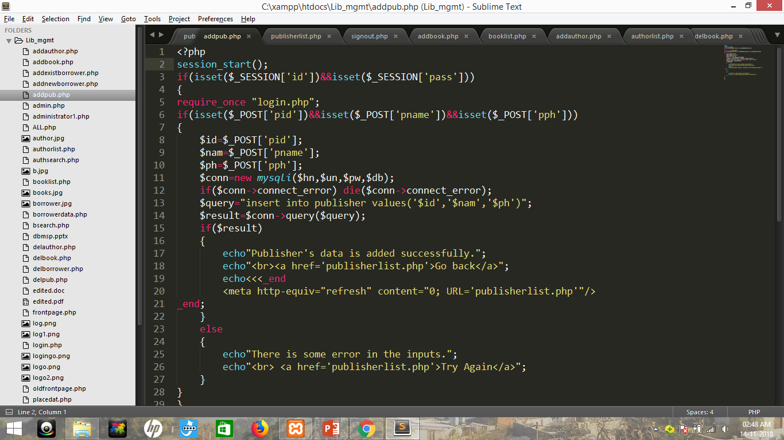
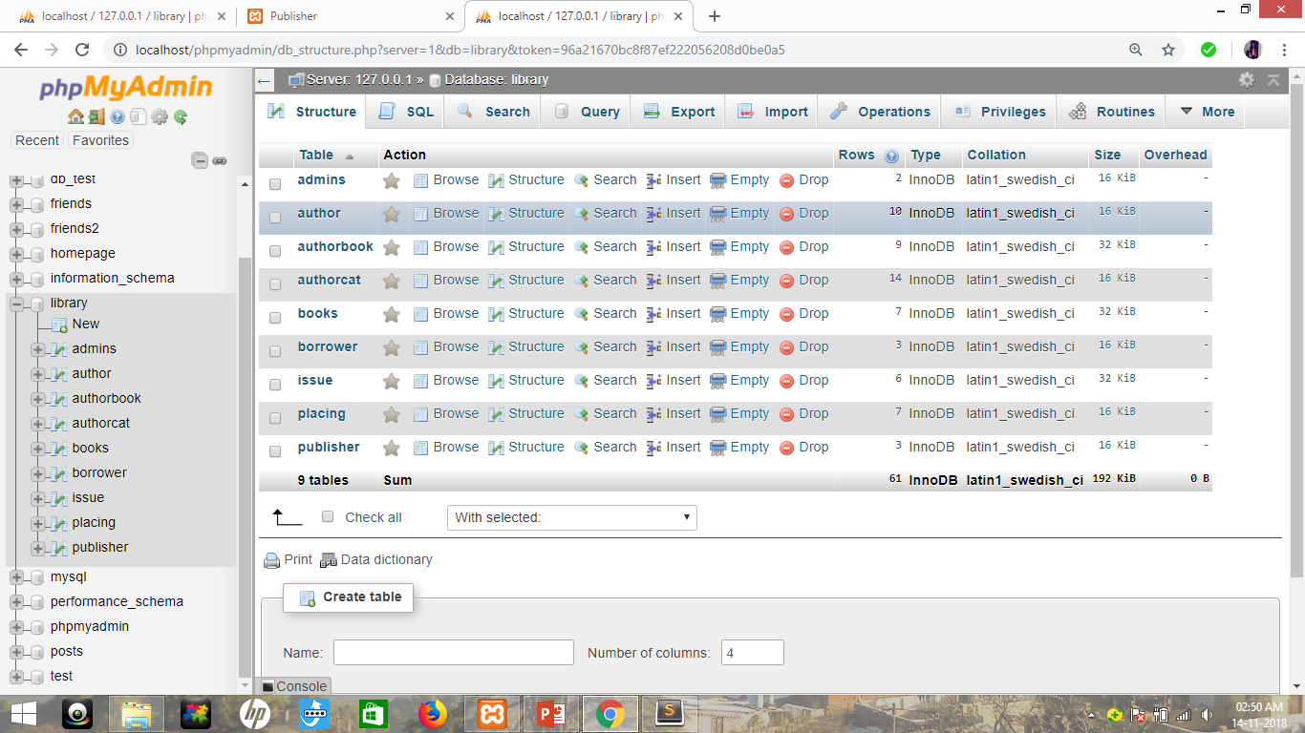
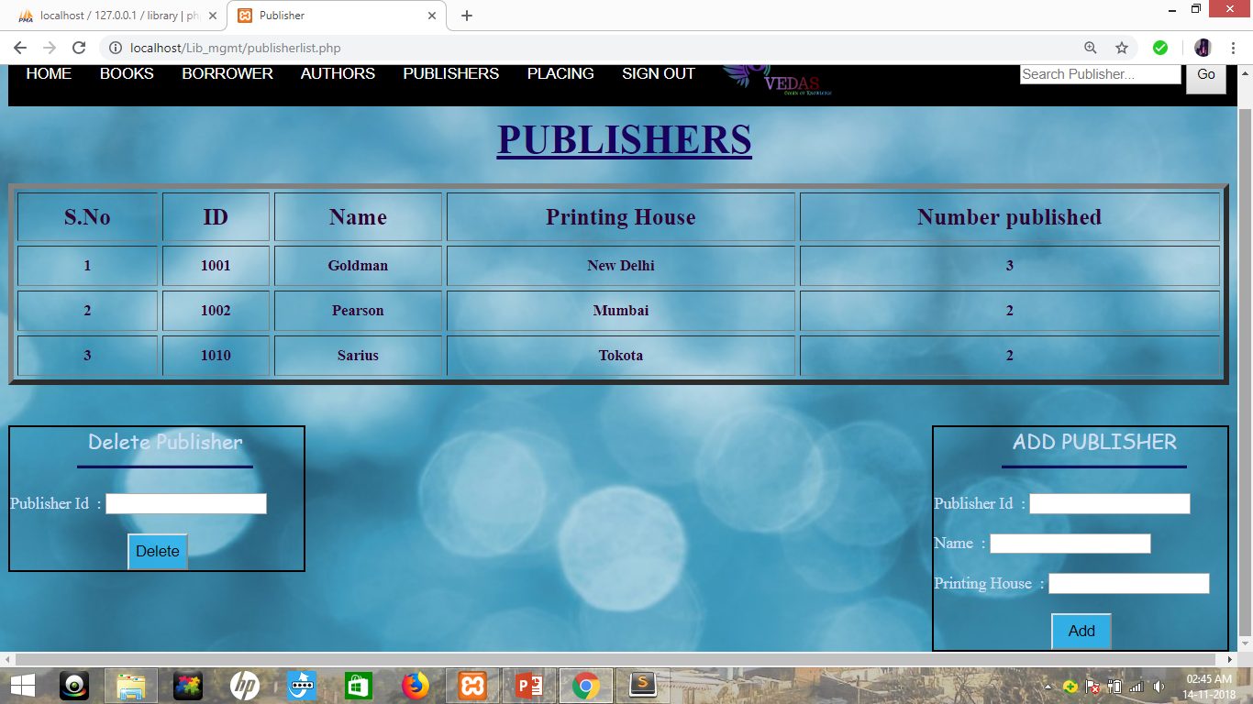
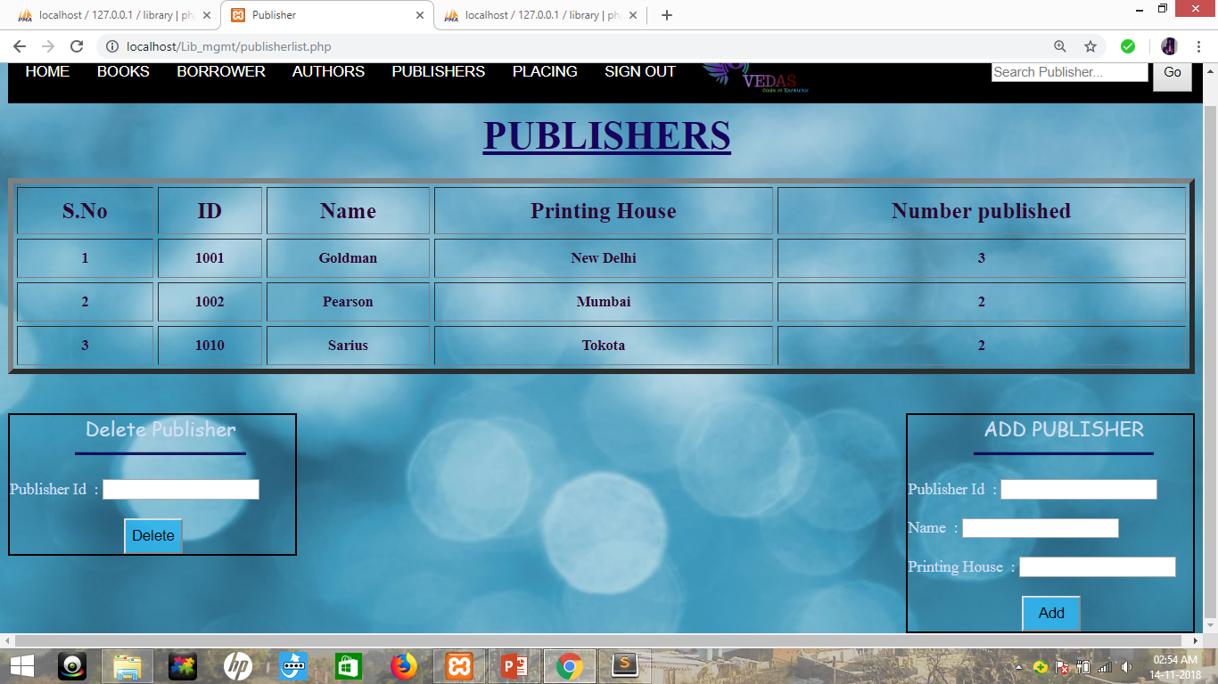
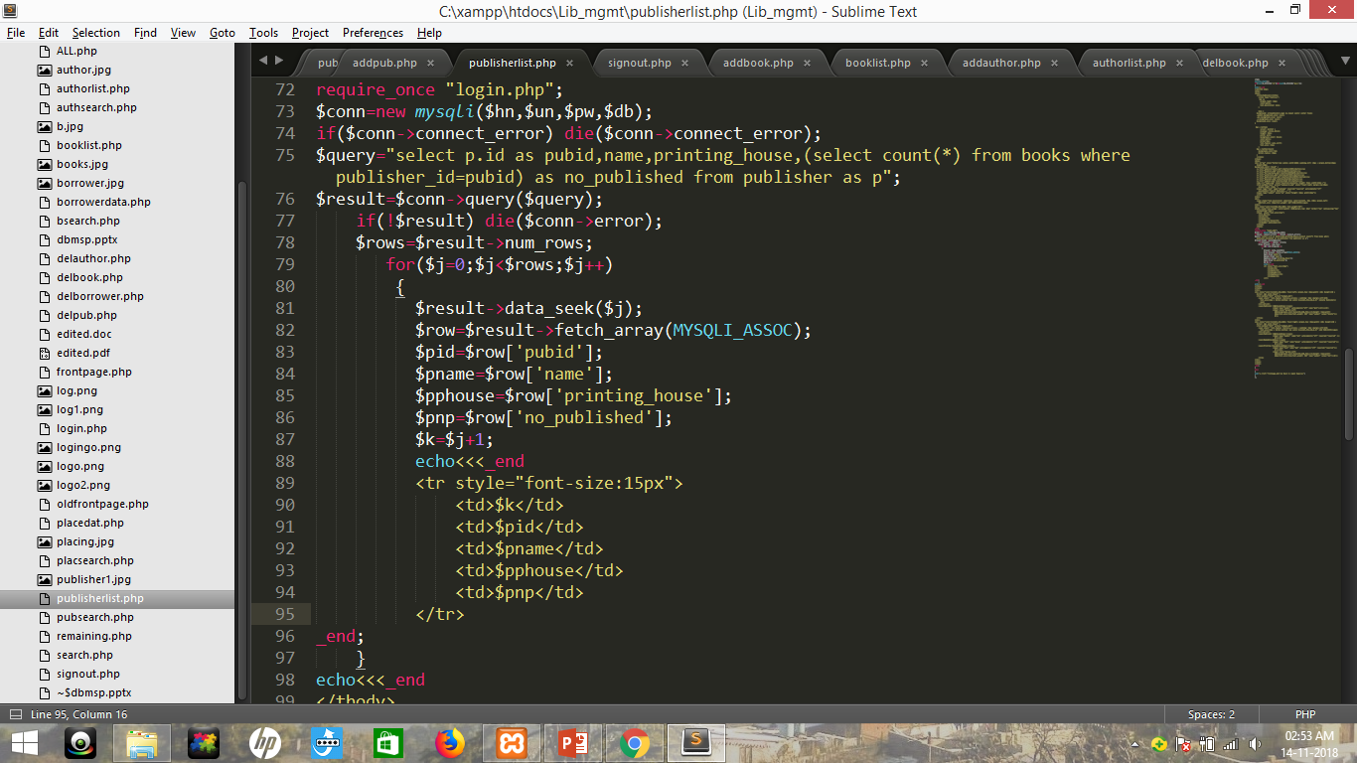

ACTUAL WORKING
FORM
PHP
DATABASE
RESULT DISPLAYED
HTML
PHP

Slide 14
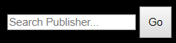
SEARCH BAR
For accessing the data quickly related to books, borrower, publisher and authors , I have used a search bar in it.
By using it we can find the detail by using their id and in some place their name.

Slide 15
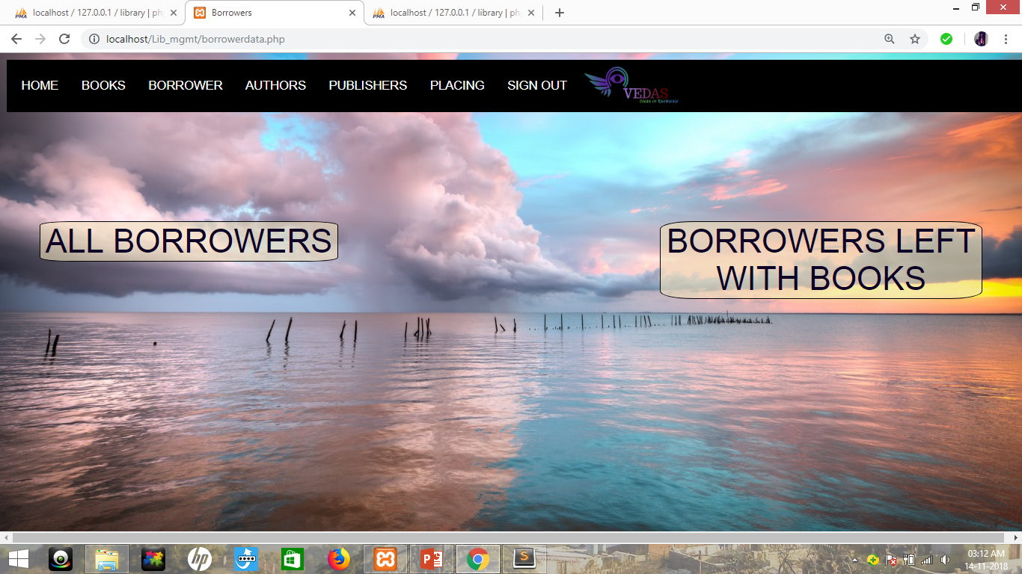
EASY HANDLING OF BORROWERS
Basically in the database there are two tables whichkeep the information of the borrowers and their trasactions.
But in GUI I have given two options:
ALL BORROWERS :- It gives information about all those borroers which have used our library in any moment of their life.
2. BORROWERS LEFT WITH BOOKS :- It is for those borrowers who have not returned some of the books.

Slide 16
SECURITY
For security purposes I have used the SESSION in my project.
When we log-in into the tool, session starts and variables are created. They store the credentials like username and password which are checked at every page so that unauthorized person can not access any random page.
At the time of log-out, the session-variables are reset and session destroys.
After that if anyone tries to access the webpage they will be unable to do so without authorization.

Slide 17
FEATURES
1. Get list of available books
2. Search for books
3. Borrow books
4. Find them in library
5. Get details of authors, publishers
6. Several constraints on book issue
7. Add new books, authors, publishers
8. Minimum duplicity of data

Slide 18
THANK YOU

